Slide 1
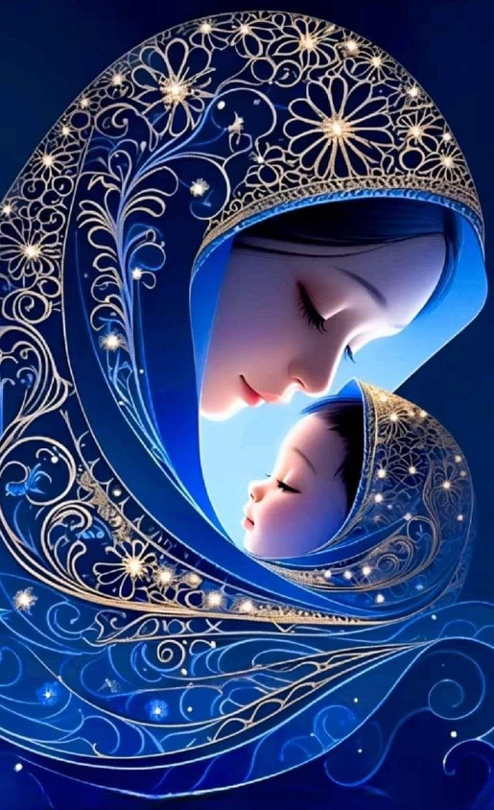
The Beloved Rosary of the blessed virgin Mary
October 5 2024, October 18, 2025
Mrs. Annette Winfield, O.P.

Slide 2

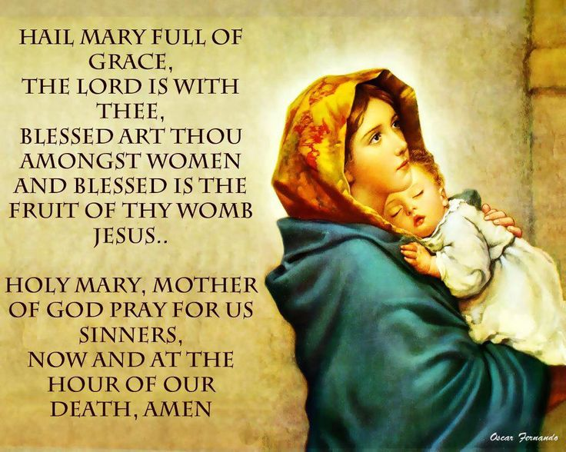
Notes:
St Louis de Montfort: “One Hail Mary prayed well is worth more than 100 prayed poorly”. (Read story of the power of on Hail Mary)

Slide 3
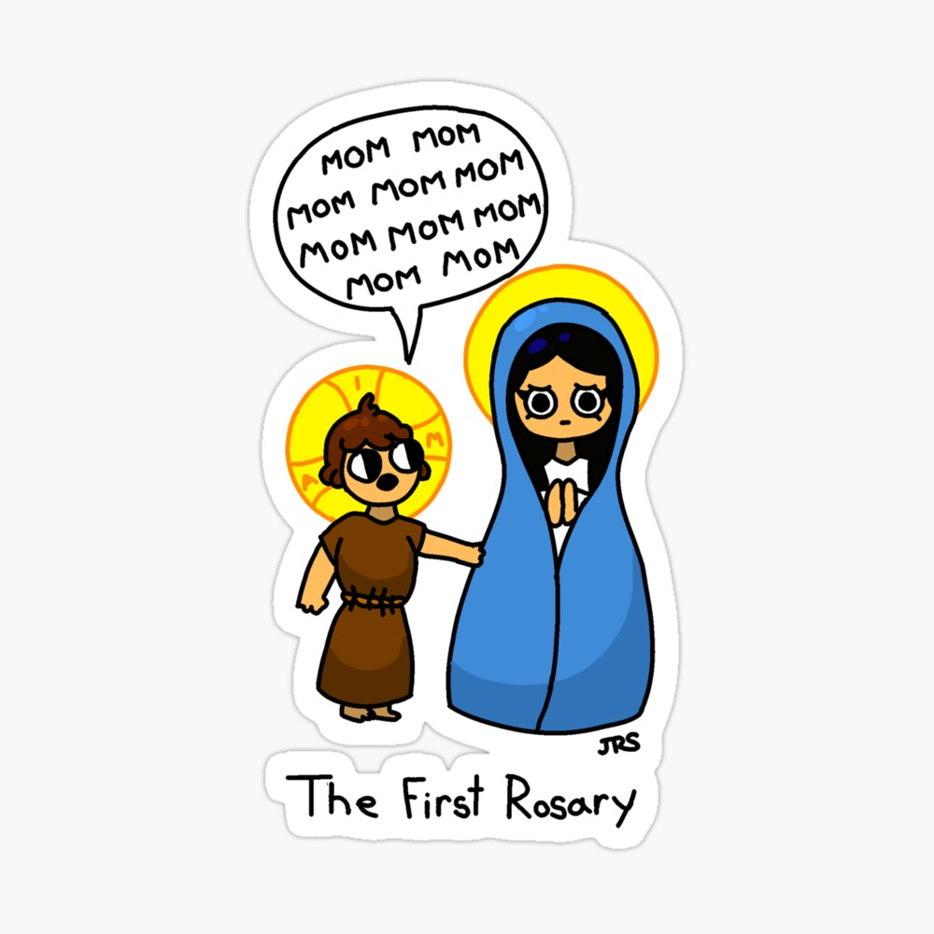
But seriously . . .

Slide 4
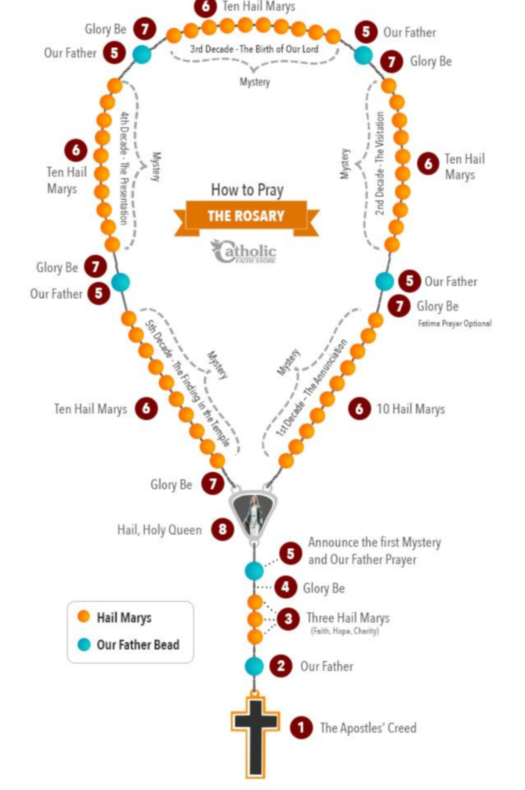

ABSOLUTE BASICS OF THE ROSARY
Mysteries – Joyful, Sorrowful, Glorious, Luminous
Hail Mary
Glory Be, Fatima Prayer, Our Father
Apostles’ Creed

Slide 5
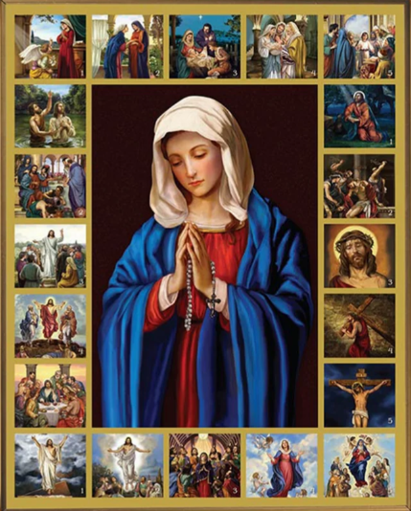
MYSTERIES
The Joyful Mysteries follow the greatest moments of joy throughout the Gospel, from the moment Mary learned she was going to be the Mother of God to the moment Mary finds Jesus in the Temple, after he was lost for three days. Mondays and Saturdays.
The Sorrowful Mysteries follow the darkest moments of the Passion story in the Gospel, from the moments of incredible anxiety and prayer Jesus experienced in the Garden of Gethsemane to the moment he dies on the Cross. Tuesdays and Fridays.
The Glorious Mysteries follow the most extraordinary moments of the Gospel and Church tradition, from the Resurrection to the Coronation of Mary as Queen of Heaven and Earth. Sundays and Wednesdays.
The Luminous Mysteries follow the incredible moments when Jesus revealed his divinity in the Gospel, Jesus’ baptism, to the moment when he gave us the Sacrament of the Eucharist.
Notes:
All Mysteries come from Scripture – the Word of God – As such they are intended to be reflected upon when praying the Rosary. There are two stories of the origin of the mysteries: one – that they were revealed to St Dominic de Guzman by the Blessed Mother in 1208 and another that they were developed by St Dominic of Prussia in the early 1400s.

Slide 6
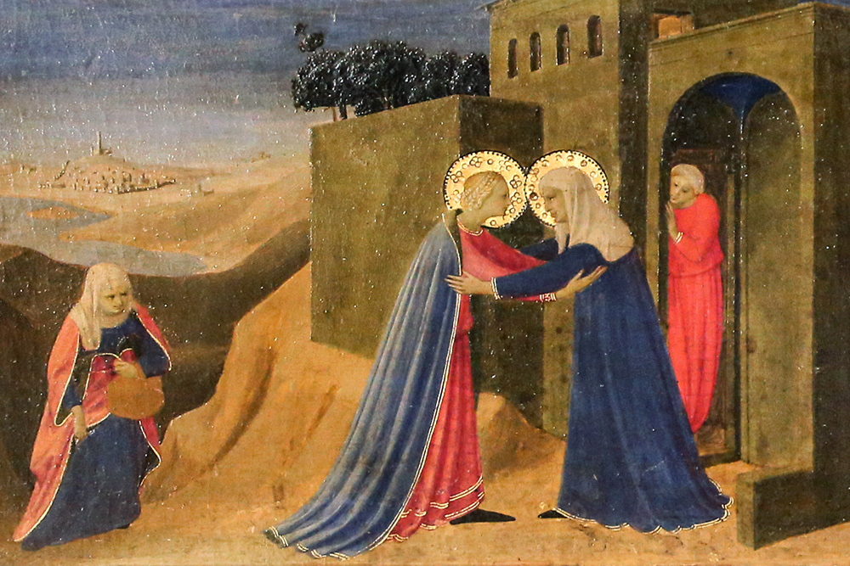
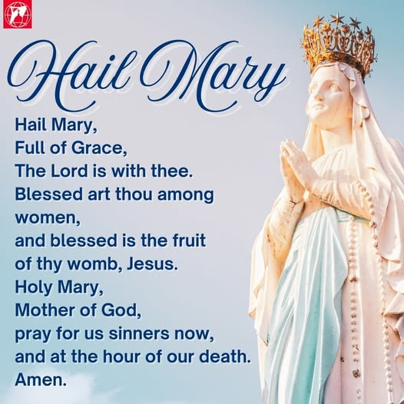
HAIL MARY
Notes:
The prayer begins, “Hail Mary, full of grace, the Lord is with thee.” This is nothing other than the greeting the angel Gabriel gave Mary in Luke 1:28 (Confraternity Version). The next part reads this way:
“Blessed art thou among women, and blessed is the fruit of thy womb, Jesus.” This was exactly what Mary’s cousin Elizabeth said to her in Luke 1:42. The only thing that has been added to these two verses are the names “Jesus” and “Mary,” to make clear who is being referred to. So the first part of the Hail Mary is entirely biblical.
The second part of the Hail Mary is not taken straight from Scripture, but it is entirely biblical in the thoughts it expresses. It reads:
“Holy Mary, Mother of God, pray for us sinners, now and at the hour of our death. Amen.”

Slide 7
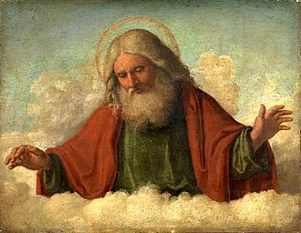
OUR FATHER
Notes:
OKA “The Lord’s Prayer”. the Our Father or Pater Noster (from its opening words in Latin), also known as the Lord’s Prayer—is even more acceptable to Protestants because Jesus himself taught it to his disciples.
It is given in the Bible in two slightly different versions (Matt. 6:9-13; Luke 11:2-4). The one given in Matthew is the one all Christians say.

Slide 8

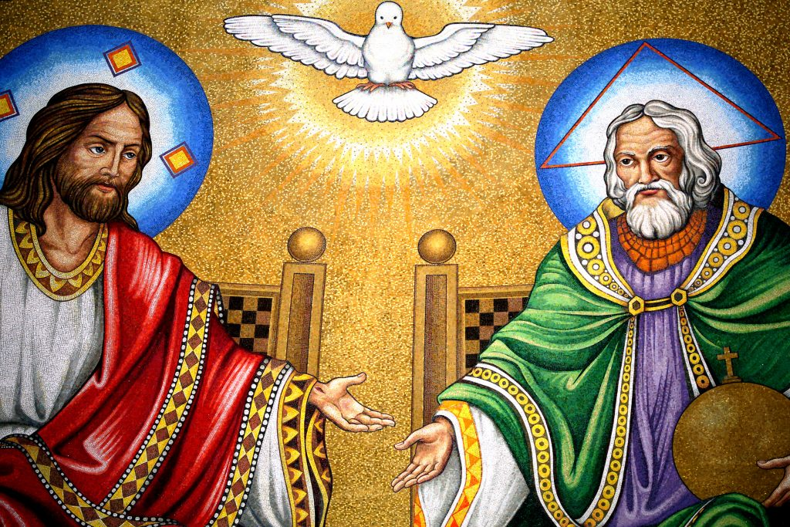
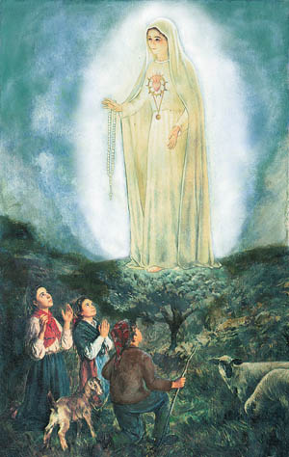
GLORY BE
FATIMA PRAYER
Notes:
Glory Be, sometimes called the Gloria or Gloria Patri. The last two names are taken from the opening words of the Latin version of the prayer, which in English reads: “Glory be to the Father, and to the Son, and to the Holy Spirit. As it was in the beginning, is now, and ever shall be, world without end. Amen.” The Gloria is a brief hymn of praise in which all Christians can join. It has been used since the fourth century (though its present form is from the seventh) and traditionally has been recited at the end of each Psalm in the Divine Office.
1917 AD: Mary appeared to three shepherd children in Fatima, Portugal, giving them many messages, including a call to pray the Rosary every single day for world peace. She invited them to add on a short prayer to every decade: “O my Jesus, forgive us our sins, save us from the fires of hell, and bring all souls to heaven, especially those in most need of your mercy.” This new update to the Rosary is called “The Fatima Prayer.”

Slide 9
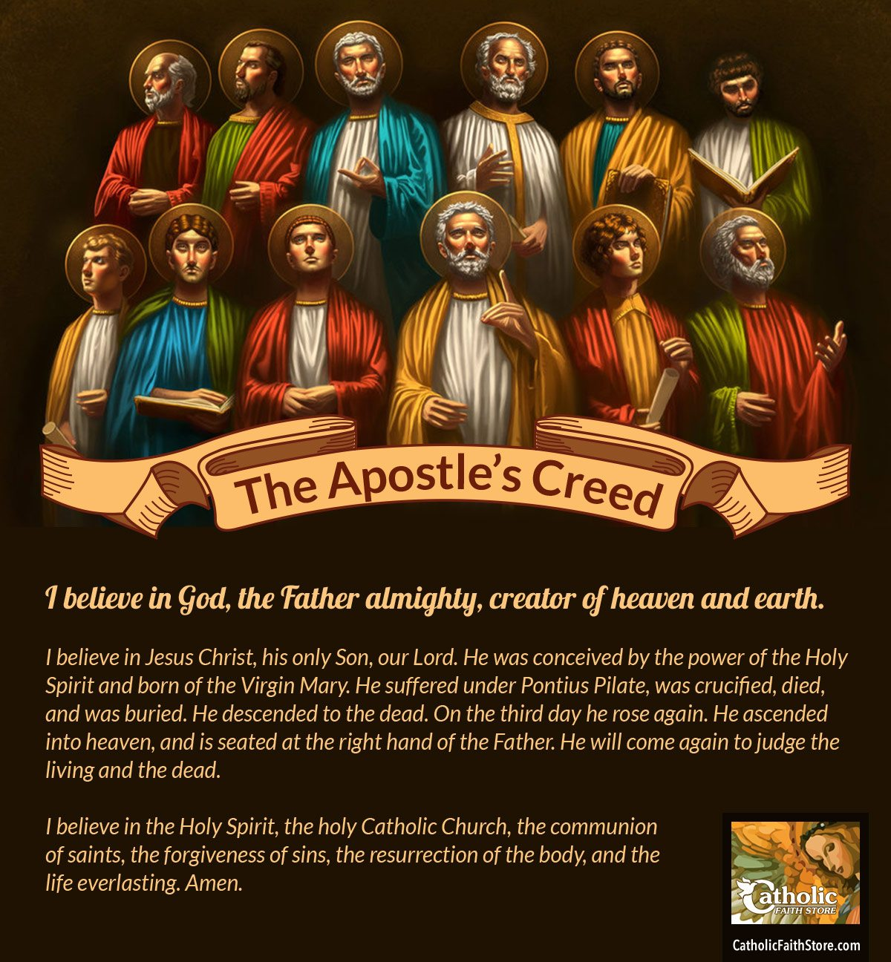
APOSTLES’ CREED
Notes:
The Apostles’ Creed is so called not because it was composed by the apostles themselves, but because it expresses their teachings. The original form of the creed came into use around A.D. 125, and the present form dates from the 400s.

Slide 10
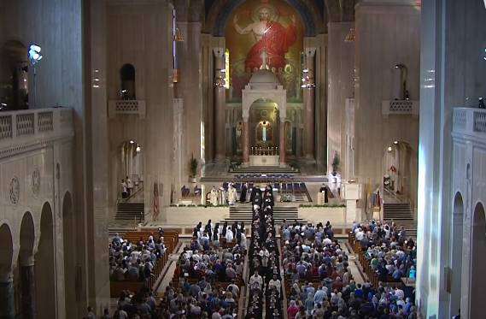
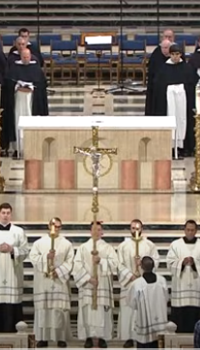
HAIL HOLY QUEEN OR SALVE REIGINA
Notes:
Hail Queen (Salve Regina), sometimes called the Hail Holy Queen. It’s the most commonly recited prayer in praise of Mary after the Hail Mary itself, and was composed at the end of the eleventh century. It generally reads like this (there are several variants):
“Hail holy Queen, Mother of mercy, our life, our sweetness, and our hope! To thee do we cry, poor banished children of Eve. To thee do we send up our sighs, mourning and weeping in this vale of tears. Turn, then, most gracious advocate, thine eyes of mercy toward us, and after this our exile show unto us the blessed fruit of thy womb, Jesus. O clement, O loving, O sweet Virgin Mary.”
It was set down in largely its current form at the Abbey of Cluny in the 12th century, where it was used as a processional hymn on Marian feasts and at the end of Compline or night prayer. The Salve Regina is traditionally sung at the end of a priest's funeral Mass.

Slide 11
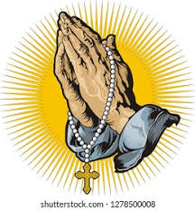
CLOSING PRAYER
O God, whose only begotten Son, by His life, death, and resurrection, has purchased for us the rewards of eternal salvation. Grant, we beseech Thee, that while meditating on these mysteries of the most holy Rosary of the Blessed Virgin Mary, that we may both imitate what they contain and obtain what they promise, through Christ our Lord. Amen.
Most Sacred Heart of Jesus, have mercy on us.
Immaculate Heart of Mary, pray for us.
Notes:
"O God, whose only begotten Son...": This opening addresses God the Father, recognizing the sacrifice of Jesus Christ, his Son.
The prayer acknowledges that Jesus, "by His life, death, and resurrection, has purchased for us the rewards of eternal life". This reflects the biblical teaching that Christ gave his life to redeem humanity (Matthew 20:28).
"...grant, we beseech Thee...": This part of the prayer is a humble and urgent petition for God's grace. The word "beseech" shows a recognition of humanity's need for God's mercy and help, following Christ's teaching to "ask, and it shall be given you" (Matthew 7:7).
"...that meditating upon these mysteries...we may both imitate what they contain and obtain what they promise...": This is the core of the petition. It connects the meditation on the rosary's mysteries—the events in the life of Jesus—with a request for practical, virtuous action.
Imitate what they contain: This is a prayer to live out the lessons of the mysteries in one's daily life, such as humility from the Joyful Mysteries or perseverance from the Sorrowful Mysteries.
Obtain what they promise: This is a request for the ultimate goal of salvation and eternal life that Christ promised to his followers (John 3:36).
"...through the same Christ our Lord. Amen": The prayer is concluded by asking for these graces through Christ, as everything is to be asked for in his name (John 14:13). "Amen," meaning "so be it," affirms belief in the prayer just spoken

Slide 12
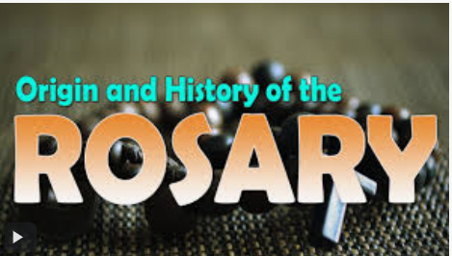

Slide 13
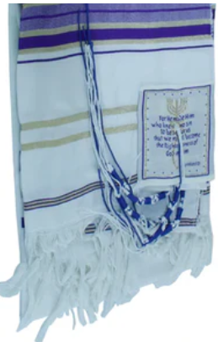
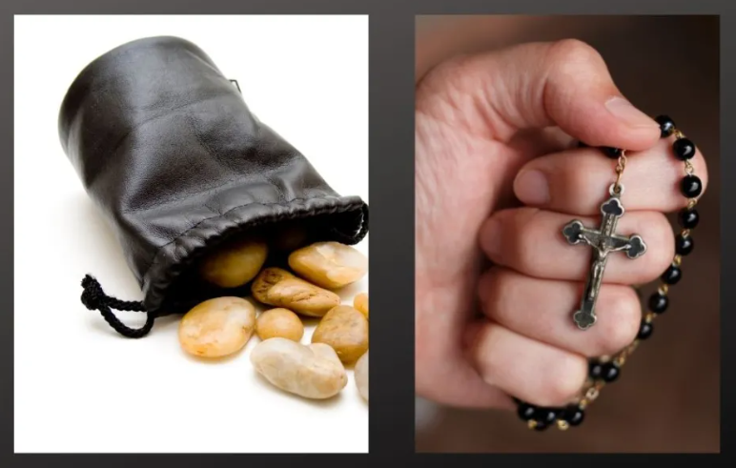
Notes:
Beads are among the earliest human ornaments and ostrich eggshell beads in Africa date to 10,000 BC. Over the centuries various cultures have made beads from a variety of material from stone and shells to clay.
The physical "rosary" is not a Christian invention. It was, and is, essentially a tallying device, known in Buddhism, Hinduism and Islam.
It has had the same function in Christianity since antiquity (pebbles, strings, chains).
Although the use of prayer beads grew within other religions, it did not enter Judaism, perhaps because of its association with those religions, and to date Judaism does not normally use prayer beads. Although not used as counting device, many Jews touch the knots on the tzitzits attached to their tallit (prayer shawl) at specific points in their prayers. Also, The Psalter was the prayer book of ancient Judaism. Although specific
daily liturgical practice in ancient Judaism is less clear, it is unquestioned and accepted as fact that ancient Jewish spirituality was deeply rooted in the Psalter of the Temple. This was the practice of praying the Psalms.
The practice of praying with beads for Christians is believed to originate with the Desert Fathers in the 3rd and 4th centuries. The carried pebbles in a small bag for counting prayers.
400’s: St Patrick recites the 150 psalms of the Psalter & encouraged the monks to do so. He urged the unlettered to make the Sign of the Cross 100x in the morning and 100x at night.
500’s Ireland: St. Columba & St. Gall urge all the faithful, not just monks, to “pray without ceasing” (I Thess. 5:17). St. Bridgit of Kildare carried a small string of stone beads for her daily prayer, “as was the custom among the hermits.”
The English word bead is from the Anglo-Saxon word ‘bede’ which translates as ‘prayer’. The practice of praying with beads spread throughout Europe and was used in Catholic monasteries. Originally they carried 150 ‘bedes’ to mark 150 Psalms which were recited over each week.
St. Paul of Thebes, for example, used to have a bag with three hundred pebbles and placed one pebble for each of the prayers he said into another, empty bag.

Slide 14
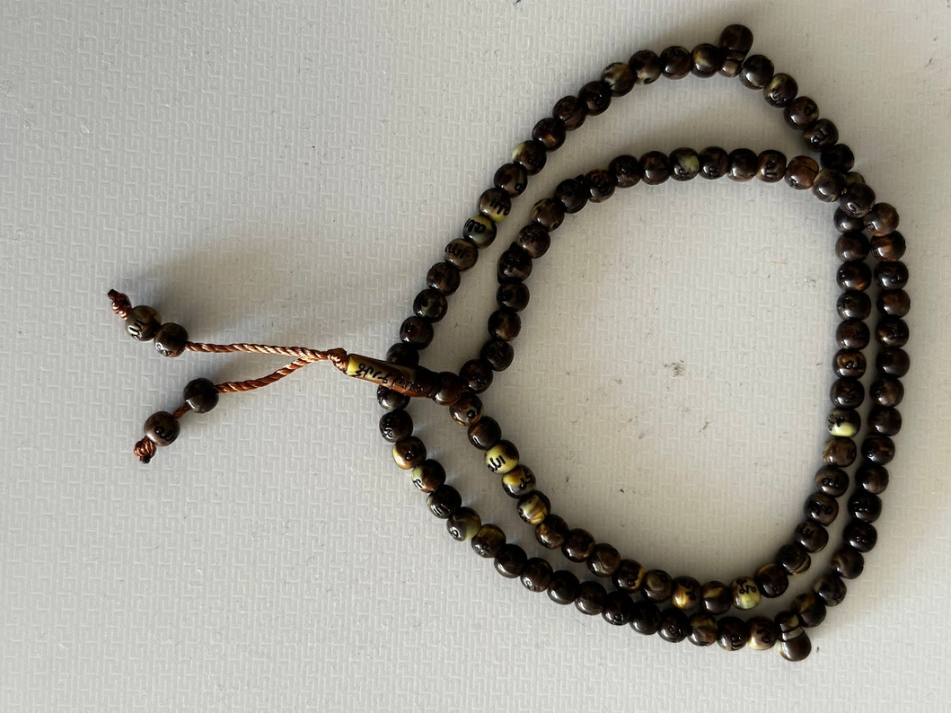
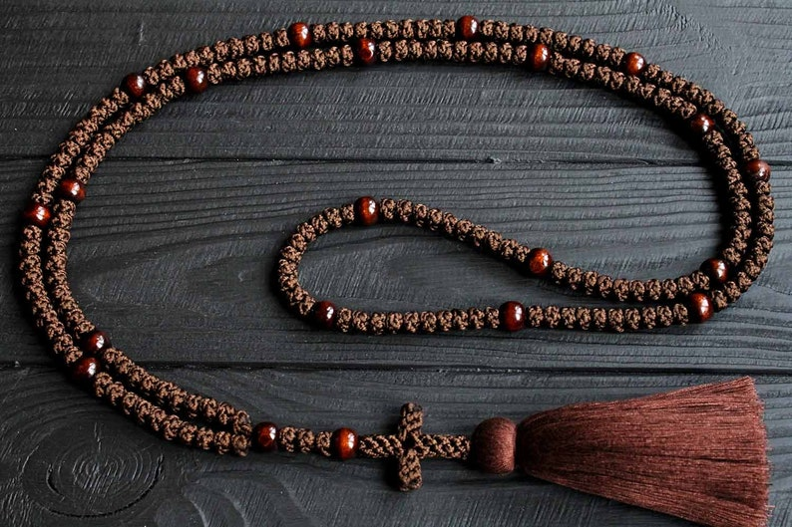
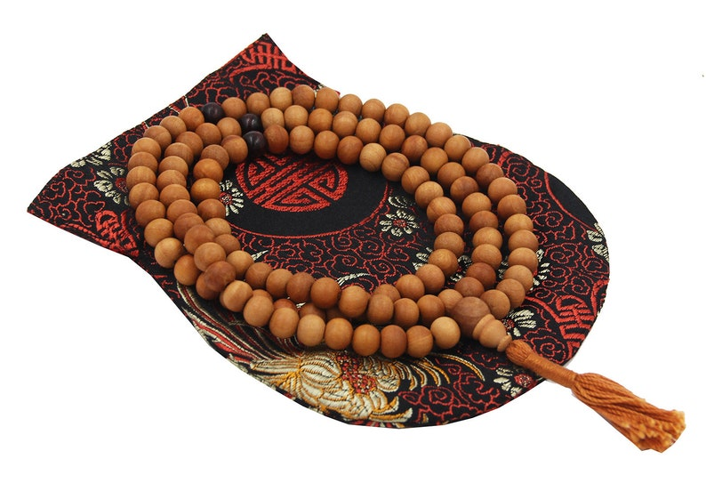
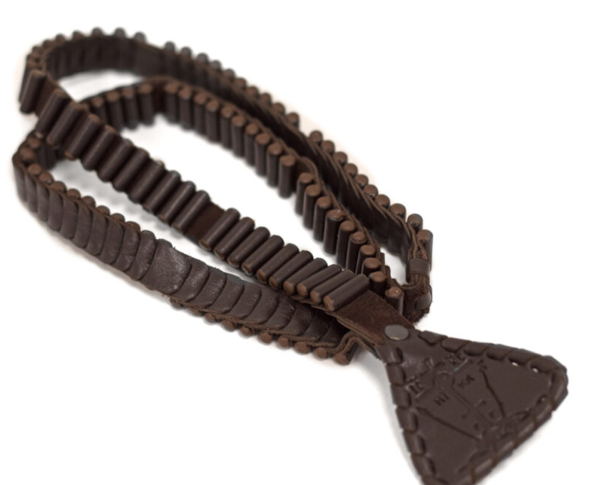
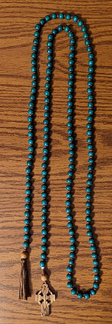
Chokti or Vervica- 200 Orthodox Prayer Knots
Islamic Prayer Beads – 99
Names of Allah
Buddhist Mala – 108 Beads
Paternoster Beads
150 Beads – Psalms or
Lord’s Prayer - Gaelic
Russian ‘ladder’
Notes:
In addition to the woolen prayer rope or "chotki" the Slavs devised a leather prayer counter with steps or ladders which was called the "vervitsa" or "step-ladder" (to heaven). Monks of the East are given the chotki or vervitsa during their monastic profession. They wear them on their left hand as a reminder to "pray always." There are woolen rosaries with 33, 50, 100, 150 and 300 knots made in a similar way to your knotted rosaries. Also there is a Rosary from Russia which is made up of 109 leather steps that you "climb" with your thumb as you go around saying the Jesus Prayer. It is divided into: 12 steps for the 12 Apostles, 17 steps for the 17 prophets 33 steps for the years Our Lord lived on earth and 38 for the weeks and days Our Lord was in the Virgin Mary's womb. There are nine larger steps signifying the choirs of angels and four triangular sides at the bottom representing the evangelists.
These developed around the same time as R C Rosary and the pebbles became beads on a rope. Larger knots separate the smaller ones every 25 or 10 knots. When it is separated every ten knots, it is to indicate a prostration to the ground every 10 prayers. Arab Orthodox & Eastern Catholics use prayer beads divided every 33 beads. Which is to say; ‘if you’ve seen one set of prayer beads – you’ve seen 1 set of prayer beads’
251-356 AD ~ EGYPT ~ St. Anthony the Great, founder of Christian monasticism in the East was given credit for bringing the Byzantine Rosary into the church by knotting a woolen cord for the counting of prayers. The prayer rope focuses on the continuous, meditative repeating of a single prayer. He tied 33 knots in the cord.

Slide 15
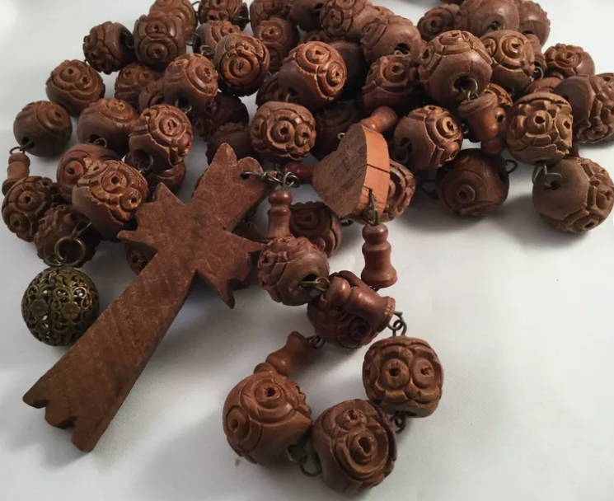
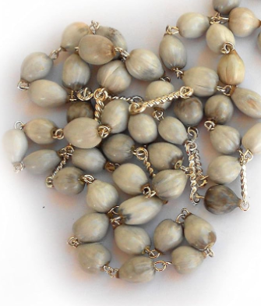
Job’s Tears
Often we use the phrase, "Knock on wood" - and proceed to do just that: knock on a table or a door or whatever wood is handy. Most do not know that the origin of the phrase and practice comes from the rosary. Rosaries in the old days were made of oak wood and were fingered in time of distress or trouble.

Slide 16
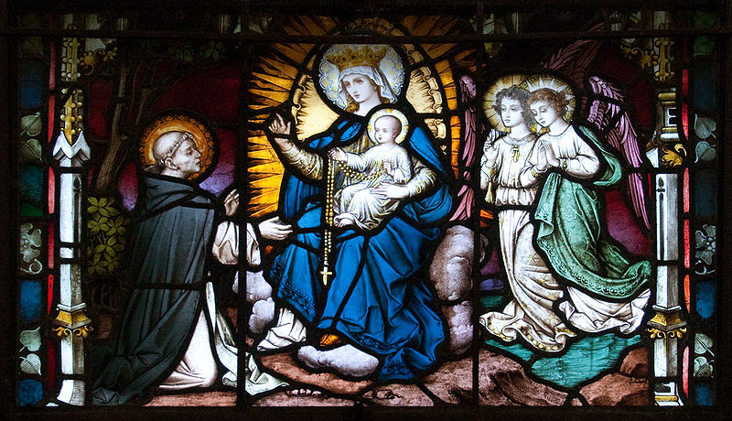
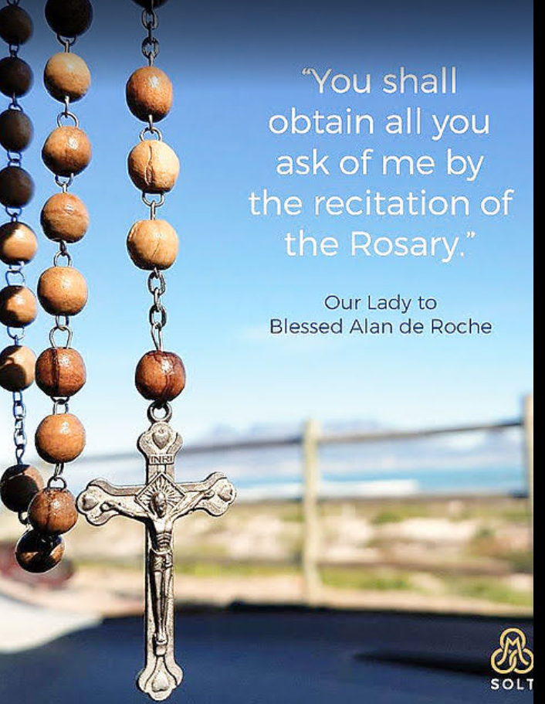
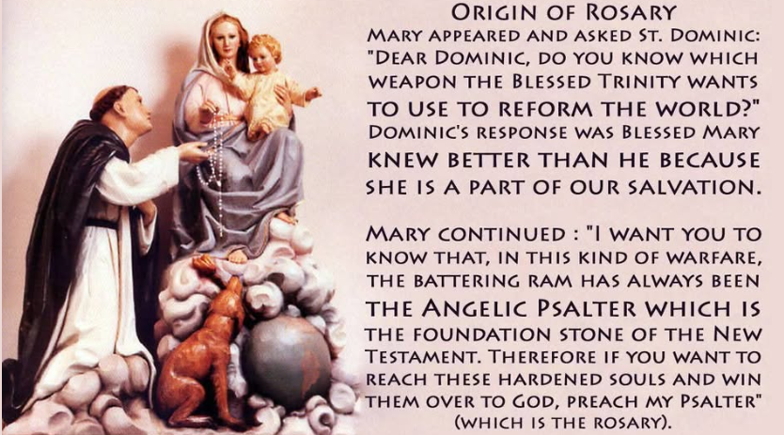
Notes:
The development of the modern rosary is often attributed to St. Dominic de Guzmán, the founder of the Dominican Order, who lived in the early 13th century. According to tradition. Saint Dominic, seeing that the gravity of people’s sins was hindering the conversion of the Albigensians, withdrew into a forest near Toulouse, where he prayed continuously for three days and three nights. During this time he did nothing but weep and do penances in order to appease the anger of God. Our Lady appeared to him, accompanied by three angels, and she said, “Dear Dominic, do you know which weapon the Blessed Trinity wants to use to reform the world?” “Oh, my Lady,” answered Saint Dominic, “you know far better than I do, because next to your Son Jesus Christ you have always been the chief instrument of our salvation.”
Then our Lady replied, “I want you to know that, in this kind of warfare, the principal weapon has always been the Angelic Psalter, which is the foundation-stone of the New Testament. Therefore, if you want to reach these hardened souls and win them over to God, preach my Psalter.”
So he arose, comforted, and burning with zeal for the conversion of the people in that district, he made straight for the cathedral. At once unseen angels rang the bells to gather the people together, and Saint Dominic began to preach.
Though some historians dispute the historical accuracy of this account, the connection between St. Dominic and the rosary remains an essential part of the Dominican Order's spiritual heritage. It was through the efforts of the Dominicans and other mendicant orders that the rosary began to take its modern form, with a structured series of prayers and meditations centered around the lives of Jesus and Mary.

Slide 17
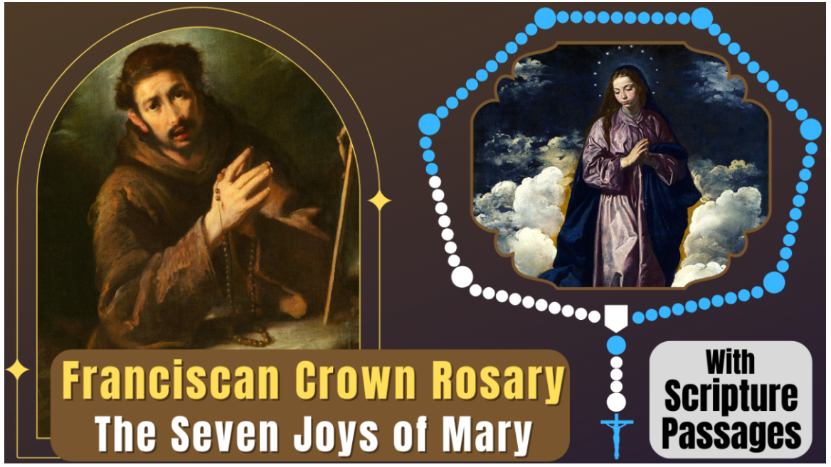
Notes:
The structure of the rosary gradually evolved between the 12th and 15th centuries. Eventually 50 Hail Marys were recited and linked with verses of psalms or other phrases evoking the lives of Jesus and Mary. During this time, this prayer form became known as the rosarium ("rose garden"), actually a common term to designate a collection of similar material, such as an anthology of stories on the same subject or theme.
The Franciscan Crown has variously been called the Franciscan Rosary, the Seraphic Rosary or the Rosary of the Seven Joys of Our Lady. The "Seven Joys" is a devotion that recalls seven joyful episodes in the life of the Blessed Virgin Mary. The practice originated among the Franciscans in early 15th-century Italy. The themes resemble the 12th-century Gaudes, Latin praises that ask Mary to rejoice because God has favored her in various ways.
According to Franciscan tradition, in 1422 an apparition of the Blessed Virgin Mary took place in Assisi, to a Franciscan novice named James. As a child, he had the custom of offering daily the Virgin Mary a crown of roses. When he entered the Friars Minor, he became distressed that he would no longer be able to offer this gift. The Blessed Virgin appeared to him to give him comfort and showed him another daily offering that he might do: to pray every day seven decades of Hail Marys, meditating between each decade on one of the seven joys that she had experienced in her life.

Slide 18
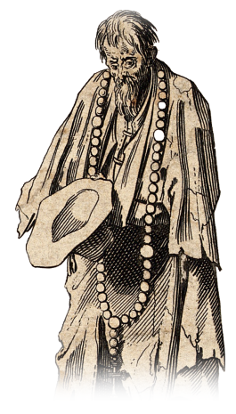
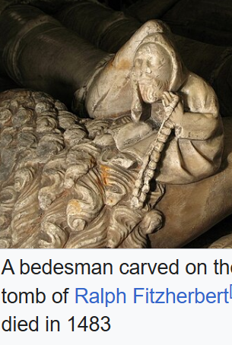
Odd Tidbit -
Bedesman
Notes:
The root "bead" comes from Old English "biddan," meaning "to pray". In Scotland, there were public almsmen which were supported by the king who were expected to pray for his welfare and that of the state in return. These men wore long blue gowns with a pewter badge on the right arm, and were nicknamed Blue Gowns. Their number corresponded to the king's years, an extra one being added each royal birthday. They were privileged to ask alms throughout Scotland.^{[4]} On the king's birthday, each bedesman received a new blue gown, a loaf, a bottle of ale, and a leathern purse containing a penny for every year of the king's life. On the pewter badge which they wore were their name and the words "pass and repass," which authorised them to ask alms.
In general, the task was to pray for souls listed on a bede-roll represented by small items on a string called 'bedes' (i.e. "prayers"). Souls who wished to be prayed for, secured their listing by giving alms, donations, or gifts.
In medieval England, a bedesman (or beadsman) was often a pensioner or almsman whose duty was to pray for his benefactor, and sometimes denoted the chaplain of a guild..

Slide 19
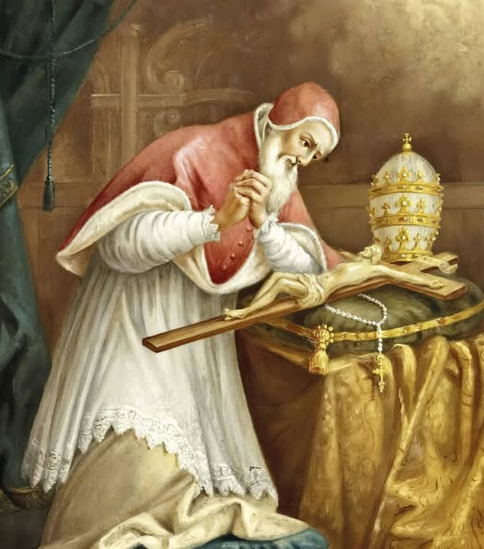
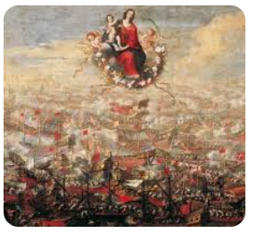
Pope Pius V (O.P.)
Encourages formation of Rosary Confraternities and Sodalities
Secured the uniformity of the Holy Rosary
Instituted Feast of Our Lady of Victory on October 7th
Notes:
in 1569, Pope Pius V officially named the Rosary as a devotional prayer in the Church. Therefore, he is affectionally called “The Pope of the Rosary.”
Pope St. Pius V also established the Feast of Our Lady of Victory in 1571 (the Feast was later changed to the Feast of Our Lady of the Holy Rosary. Pope St. Pius V wholeheartedly gave credit to the Virgin Mary for the Oct. 7, 1571, victory for the Church and Christians of Spain and Venice over Turks, who waged war on all Christianity.
The saint was a Dominican friar devoted to praying the standard 15 decades of the rosary (joyful, sorrowful, and glorious) as given through St. Dominic.

Slide 20
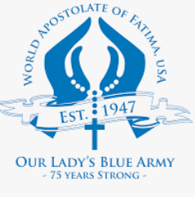
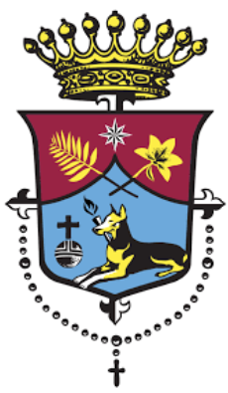

Blue Army of Our Lady of Fatma
Daily Rosary
Addition of Decade Prayer - “O my Jesus, forgive us our sins, save us from the fires of hell. Lead all souls to heaven, especially those in most need of Thy mercy.”
Confraternity of the Most Holy Rosary –
Unity in prayer
Indulgences
Commitment
Notes:
The Rosary Confraternity is a spiritual association of the Catholic Church, established more than 500 years ago, the members of which strive to pray the entire Rosary during the course of one week. They form a union of hundreds of thousands of the faithful throughout the world who, along with their own intentions, include the intentions and needs of all its members. The Rosary Confraternity is a spiritual association of the Catholic Church, established more than 500 years ago, the members of which strive to pray the entire Rosary during the course of one week. They form a union of hundreds of thousands of the faithful throughout the world who, along with their own intentions, include the intentions and needs of all its members.
In the early years of the Cold War, having discovered Our Lady of Fatima’s message, Msgr. Harold V. Colgan partnered with John M. Haffert to create the “Blue Army of Our Lady of Fatima”.
Members of this “Blue Army” were the spiritual force standing against the atheistic policies of the Soviet Union and their Red Army. They pledged to offer their daily sufferings and difficulties for the conversion of sinners, to pray the Rosary daily, to wear the Brown Scapular as a sign of consecration to Mary’s Immaculate Heart, and to practice the Five First Saturdays devotion.
The pledge, which Sister Lucia herself helped formulate, quickly gained popularity throughout the United States and soon became a worldwide movement, with between thirty and forty million people having signed the Blue Army Pledge. The Blue Army of Our Lady of Fatima officially became the World Apostolate of Fatima and on October 7, 2010

Slide 21
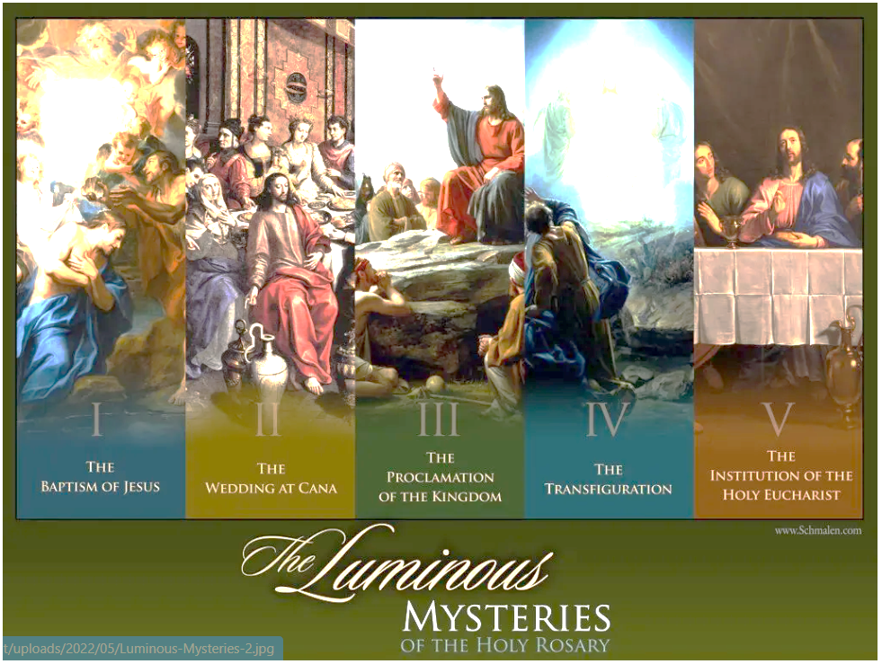
Notes:
The Luminous Mysteries (or Mysteries of Light) were introduced as “a proposed addition to the traditional pattern” by Pope John Paul II, in October 2002, at the start of the Year of the Rosary. These mysteries focus on the public ministry of Jesus Christ, and were added in the words of St. John Paul “for the Rosary to become more fully a ‘compendium of the Gospel’”; in contemplating revelatory moments in Christ’s public ministry, the Christological depth of the Rosary is brought out more fully.
In St. John Paul’s words: Moving on from the infancy and the hidden life in Nazareth [the Joyful Mysteries] to the public life of Jesus, our contemplation brings us to those mysteries which may be called in a special way ‘mysteries of light’. Certainly the whole mystery of Christ is a mystery of light. He is the ‘light of the world’ (Jn 8:12). Yet this truth emerges in a special way during the years of his public life, when he proclaims the Gospel of the Kingdom.
--five Luminous Mysteries as proposed by Blessed George Preca (1950s)
Jesus is baptized by John in the Jordan.
Jesus reveals himself as God through his word and miracles, such as the wedding at Cana.
Jesus preaches the Kingdom of God and calls people to conversion.
Jesus is transfigured on the mountain.
Jesus institutes the Eucharist at the Last Supper.

Slide 22
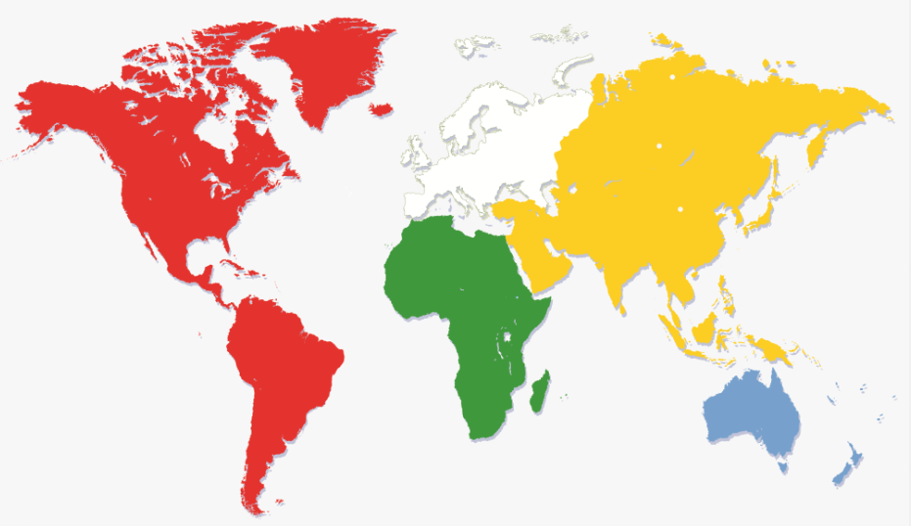

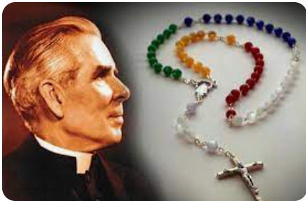
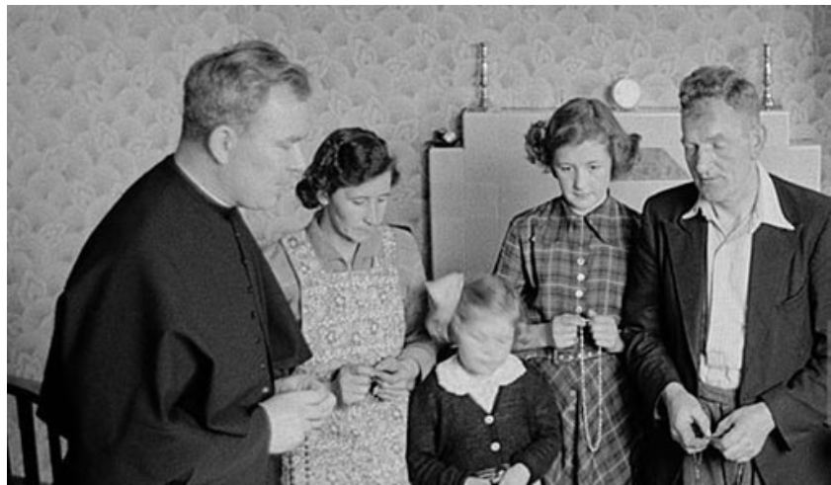
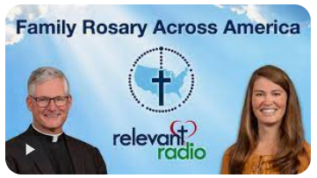
The Story Continues . . .
World Mission Rosary
Notes:
Patrick Peyton was born to an Irish Catholic family, at a time of hardships in the early years of the 20th century. His family were staunchly Catholic farmers, who prayed the Rosary together as a regular practice. As a child, Peyton had inclinations to pursue a vocation as a priest. Due to poverty and the need to help his family earn a living, that pursuit did not bear fruit until he was already in his twenties as an immigrant in the United States.
Peyton entered Seminary at the U of Notre Dame. In 1941 he learned that he had tuberculosis. He immersed himself in meditation while praying the Rosary. A few months later, doctors discovered that the tuberculosis had disappeared. He became a priest and dedicated himself to families and the Rosary.
On May 13, 1945, Mother's Day, Peyton's program debuted on nationwide radio with the Sullivan family (some gave all). Words like "The Family That Prays Together Stays Together" as well as "A World at Prayer is a World at Peace“ were just the beginning of a world wide movement.
World Mission Rosary: In February of 1951, Archbishop Fulton J. Sheen (national director of the Society for the Propagation of the Faith from 1950 to 1966), in a radio address (The Catholic Hour), inaugurated a World Mission Rosary. “We must pray, and not for ourselves, but for the world. To this end, I have designed the World Mission Rosary. Each of the five decades is of a different color to represent the continents.”
Praying this Rosary, Archbishop Sheen said, would “aid the Holy Father and His Society for the Propagation of the Faith by supplying Him with practical support, as well as prayers, for the poor mission territories of the world.”
GREEN for the forests and grasslands of AFRICA; BLUE for the ocean surrounding the ISLANDS OF THE PACIFIC; WHITE symbolizing EUROPE, the seat of the Holy Father, shepherd of the world; RED calling to mind the fire of faith that brought missionaries to the AMERICAS, and YELLOW, the morning light of the East, for ASIA.
Family Rosary Across America - Rev. Francis Hoffman “Fr. Rocky”, Relevant Radio – 1st live, interactive Rosary on the radio – 2018. “Relevant Radio is truly thrilled that we can now bring the entire country together on a daily basis to pray the rosary as a family. To our knowledge, this has never happened before, and we are full of hope that this pious devotion will bring many graces to our families, listeners, Church and country,” said Rev. Francis Hoffman “Fr. Rocky”, Executive Director. Famous for promoting the Walk to Mary in Champion Wisconsin and saying “Keep a a Rosary in your pocket and God in your heart”
“Imagine your joy as you hear people praying for your intentions, and your joy knowing that your prayers are helping others in our family of faith who are in need! Imagine people all across America joining their voices together in the rosary at the same time. Join your voice with them in this live rosary broadcast,” said host Fr. Dave, pastor of St. Bruno Catholic Church in Whittier, CA, and founder of “The University Series”. The Family Rosary Across America is a live and interactive radio program bringing together Catholics across the nation to pray the rosary. Join 100,000 people each evening as we pray together and for one another.

Slide 23
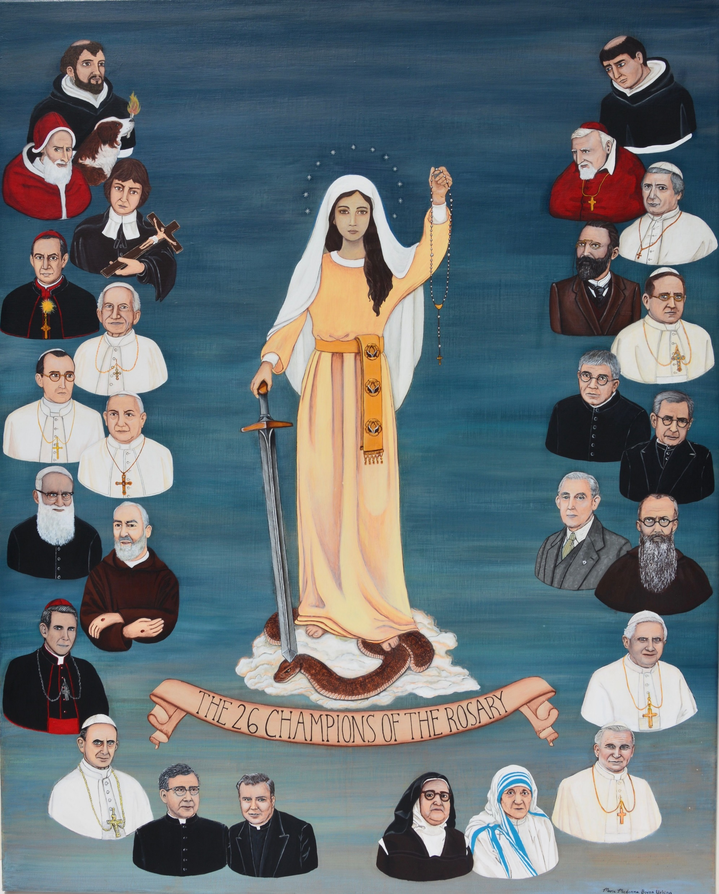
SAINTS OF THE ROSARY
Notes:
Many saints grew attached to praying the Rosary as young children, taking Mary into the heart of their lives. St Louis-Marie de Montfort was born in France during the seventeenth century. Not content, as a young boy, with praying the Rosary, he taught his younger brothers and sisters, and his classmates at school, to do the same. After his ordination as a priest, he became a wandering missionary, spreading devotion to Our Lady as part of parish missions.

Slide 24
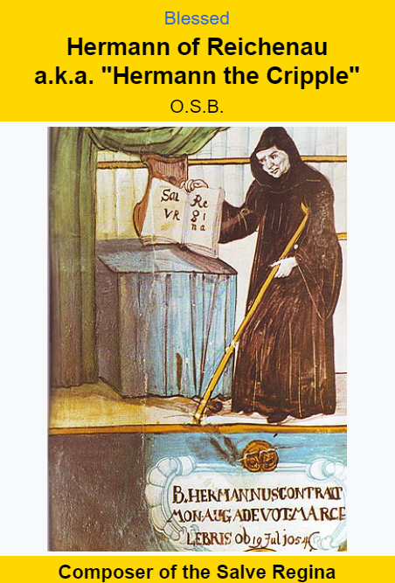
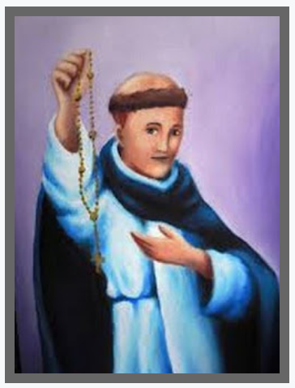
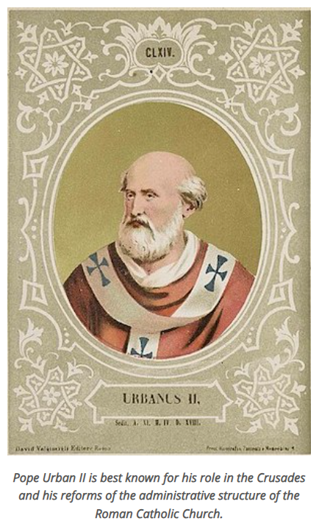
Notes:
1014 Germany: Blessed Herman, a Benedictine monk, writes many
hymns, among them Salve Regina (“Hail, Holy Queen”). Beginning at the Abbey of Reichenau in Germany, the Salve Regina is added as the concluding prayer of the Rosary.
1088 Italy: Pope Urban II, at a Synod of Bishops in Rome, requires all
clergy to pray the Rosary daily. Specifically, he urges that the devotions include the Apostles Creed, the Paternoster and the Ave. Also, by the end of the 10th century, the praying of Ave’s (on the Ave’s) is coming to replace the Paternoster.
In the mid 15th Century in a Dominican monastery in Brittany, Alan de la Roche experienced visions from the Blessed Virgin Mary and the Lord which eventually convicted him to revive and renew the Dominican Rosary. De la Roche was not the perfect emissary for this divine mission. At one point, Jesus appeared to De la Roche and said: "You have all of the learning and understand that you need to preach my mother's rosary, and you are not doing so. The world is full of devouring wolves, and you, unfaithful dog, know not how to bark." Blessed Alan stressed the 15 mysteries of the Dominican Rosary, rather than the alternative of 50 clauses of the Carthusian Rosary. Moreover, the 150 Hail Marys imitated the 150 psalms of the Old Testament, which harkened back to the proto-origins of the lay Marian psalter. Blessed Alan was successful at renewing popular devotion to the Rosary and reinvigorating the Confraternity of the Rosary. The Confraternity featured "after death" benefits for Rosarians. Thus Blessed Alan de la Roche may be considered one the greatest champions of the Rosary to ever live.

Slide 25
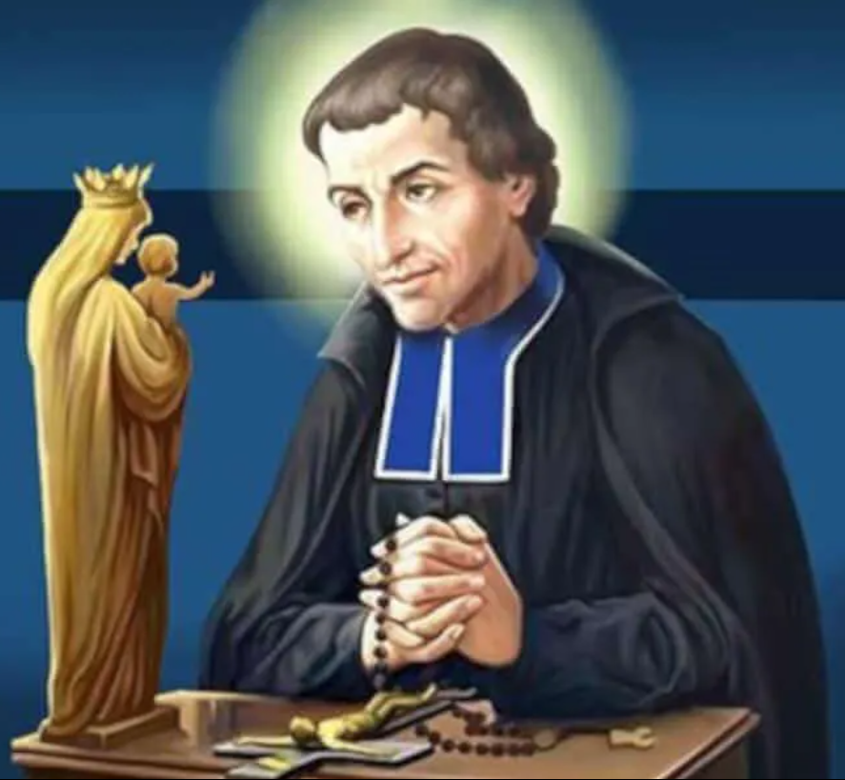
The Secret of The Rosary
St. Louis de Montfort
Notes:
St. Louis de Montfort is well known today because of the popularity of his Total Consecration to Jesus Christ through Mary. Ironically, he died in 1716, while this manuscript was not discovered until 1842, and not published until May 12, 1853, when the Vatican declared it free from theological error.
In 1715, he founded the Missionaries of the Company of Mary.
In his book ‘The Secret of the Rosary’, he wrote: “I beg of you to beware of thinking of the Rosary as something of little importance - as do ignorant people, and even several great but proud scholars. Far from being insignificant, the Rosary is a priceless treasure which is inspired by God.
Almighty God has given it to you because he wants you to use it as a means to convert the most hardened sinners and the most obstinate heretics. He has attached to it grace in this life and glory in the next. The saints have said it faithfully and the Popes have endorsed it.” Copyright © Montfort Missionaries, 2001-2016

Slide 26
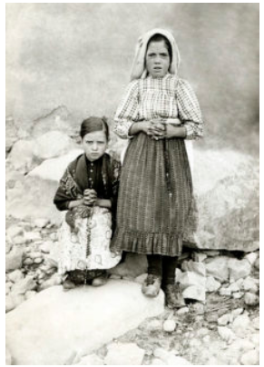
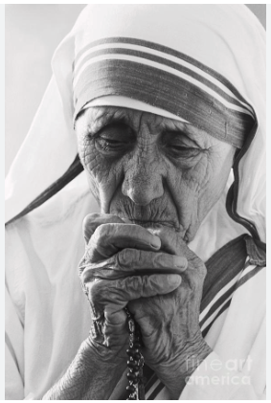
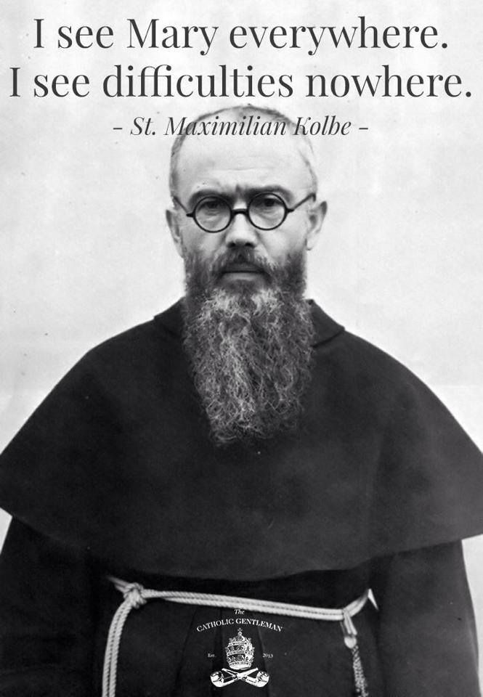
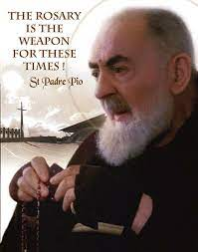
Notes:
Sr. Lucia of Fatima said “Thus, the Rosary is the prayer which God, through His Church and Our Lady, has recommended most in­sistently to us all as a road to and a gateway of salvation: ‘Pray the Rosary every day.’” Sister Lucia doesn’t mince words: “Those who give up saying the Rosary and who do not go to daily Mass have nothing to sustain them, and so end up by losing themselves in the material­ism of earthly life.”
St. Maximilian Maria Kolbe is the founder of the Militia Immaculata. He encourages all with aspirations such as, “A prayer both simple and sublime that the Immaculata herself indicated when she appeared in Lourdes is the holy rosary. May it become the sword of each knight of the Immaculata, just as the Miraculous Medal is the bullet that strikes down evil!”
St. Maximilian witnessed his faith and devotion to the rosary even in the most challenging of situations. When he was arrested and sent to Pawiak prison in Warsaw, he was asked repeatedly by a guard if he really believed in the rosary. Never denying it, he was beaten so fiercely that his comrades thought he was dead. He ultimately arose and encouraged all towards hope.
The Rosary was St. Teresa of Calcutta’s favorite and constant prayer. She would pray the Rosary anywhere, but she particularly loved praying it before the Blessed Sacrament.
“CLING TO THE ROSARY AS THE CREEPER CLINGS TO THE TREE — FOR WITHOUT OUR LADY WE CANNOT STAND.” The Rosary became a hallmark of the Missionaries of Charity’s way of life. They would pray the rosary in haste as they went to serve the people of Calcutta with Our Lady’s help and guidance.
Padre Pio encouraged his spiritual children to carry a Rosary with them at all times, and to pray it every day. Padre Pio is known for referring to the most holy Rosary as a weapon: “Love the Madonna and pray the Rosary, for her Rosary is the weapon against the evils of the world today.” Padre Pio would fill any spare moment he had with the recitation of the Rosary. Oftentimes, he would pray the Rosary without people knowing. Saint Pio blessed thousands of Rosaries in his lifetime. Two days before Padre Pio died, he said: “Love Our Lady and make her loved. Recite the Rosary and recite it always. And recite it as much as you can.”

Slide 27
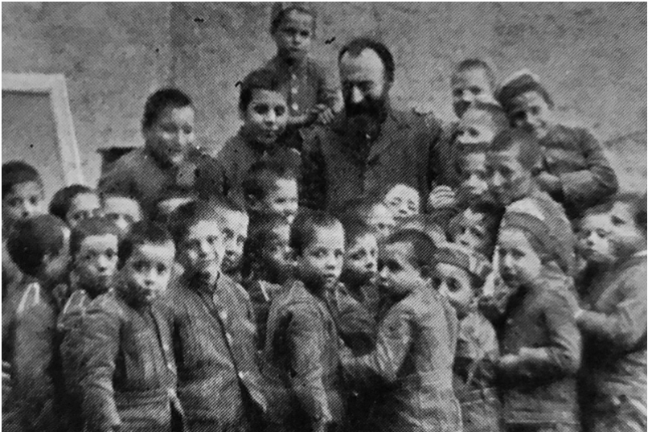
“My only desire is to see Mary who saved me and who will save me from the clutches of Satan.”
– Blessed Bartholomew Longo’s last words
Saint Bartolo Longo, O.P. (Oct 19th)
Feast Day – October 5th
Catholic kid grows up in religious family, goes away to university, falls in with a bunch of drug-fueled Satanic pagans, becomes a Satanic high priest, comes to his senses and realizes he's made the stupidest mistake world history and ultimately reverts back to the Church.
Notes:
Bartolo Longo was born in the small town of Latiano, near Brindisi, in southern Italy on February 10, 1841. His parents, Dr. Bartolomeo Longo and Antonina Luparelli, were wealthy and exceptionally devout Catholics who prayed the Rosary together daily.
Longo became alienated from the Church when his mother died in 1851. Being far from his family when he left to study law at the University of Naples, he drifted further away. The final coup de grâce occurred when he fell in with a paganic group which "ordained" him as a Satanist priest.
He participated in séances, fortunetelling and orgies. He fooled himself into thinking he could do "real" magic and that just set him up for a greater fall than the First One. He felt motivated to publicly ridicule Christianity at every turn and did everything within his power to subvert Catholic influence in society and culture. He even convinced many other Catholics to leave the Church and participate in occult rites.
But the more he experimented with dark forces, the deeper he sank into depression and demonic obsession. Joy, like God, were far from him. In their stead, his life was marked with extreme depression, paranoia, hatred, confusion and nervousness. He was horribly afflicted by dark diabolical visions which frightened him and threw him into a cycle of ever declining health. He ultimately experienced a mental breakdown.
In his darkest moments, he heard his deceased father begging him to: "Return to God! Return to God!" greatly moved by this vision, Longo turned to his old friend Professor Vincenzo Pepe. Vincenzo convinced Longo to abandon Satan and introduced him to Fr. Alberto Radente, a Dominican priest. He heard Longo's confession and brought him back to God and His Church.
One evening, as he walked near chapel at Pompeii, Longo had a profound mystical experience about which he wrote later:
As I pondered over my condition, I experienced a deep sense of despair and almost committed suicide. Then I heard an echo in my ear of the voice of Friar Alberto repeating the words of the Blessed Virgin Mary: ‘If you seek salvation, promulgate the Rosary. This is Mary's own promise.’ These words illumined my soul. I went on my knees. ‘If it is true ... I will not leave this valley until I have propagated your Rosary.’
Longo was so moved, he attended a séance and in the middle of it, stood up raising a medal of the Blessed Virgin Mother and yelled, "I renounce spiritism because it is nothing but a maze of error and falsehood."
On March 25, 1871, Longo became a Third Order Dominican and took the name Br. Rosario in honor of the Rosary. He joined a charitable group in Pompeii and worked with Countess Mariana di Fusco, a wealthy local widow who he married a year later at Pope Leo XIII's recommendation.
The devout couple started a confraternity of the Rosary and searched for a painting of the Blessed Virgin to serve as a spiritual focus for the group. Sister Maria Concetta de Litala of the Monastery of the Rosary at Porta Medina gave one which she found at a Neapolitan junk shop. And, as they say, good things don't come cheap and cheap things don't come good.
The painting portrayed Our Lady of the Rosary with Saint Dominic and Saint Catherine of Siena, but only barely. It was poorly executed and in miserable condition but he viewed it as a divine gift. He later described it in his journal:
Not only was it worm-eaten, but the face of the Madonna was that of a coarse, rough country-woman ... a piece of canvas was missing just above her head ... her mantle was cracked. Nothing need be said of the hideousness of the other figures. St. Dominic looked like a street idiot. To Our Lady's left was a St. Rose. This I had changed later into a St. Catherine of Siena ... I hesitated whether to refuse the gift or to accept ... I took it.
He repaired it and had a more competent artist touch it up and had it installed at a ramshackle church which he also repaired in October, 1873. Miracles were reported within hours of its installation. Seeing the devotion of the pilgrims, the bishop of Nola encouraged Bartolo to construct a larger church. The born-again Catholic approached architect Giovanni Rispoli to build saying:
In this place selected for its prodigies, we wish to leave to present and future generations a monument to the Queen of Victories that will be less unworthy of her greatness but more worthy of our faith and love.
Construction began on May 8, 1876. Cardinal La Valetta consecrated the church in May, 1891. In 1906, Bartolo and his wife donated the Pompeii shrine to the Holy See. Bartolo continued to promote the Rosary until his death on October 5, 1926, at the age of 75. He tirelessly evangelized young people at parties and in local cafes, explaining the dangers of occultism to them.
In 1939, the church Bartolo and his wife built was enlarged and reconsecrated as a basilica. It was officially renamed the Basilica of Our Lady of the Most Holy Rosary of Pompeii. It soon became a focus of pilgrimages for more than a century. Apparently, most Catholics and non-Catholics found the church built by an ex-Satanist to be devilishly irresistible.
When Bartolo died, the call for his canonization was immediate. Pope St. John Paul II beatified him on October 26, 1980 calling him the "Apostle of the Rosary." More than 30,000 people attended the ceremony. Every school student in Christendom knows what happened to the city of Pompeii on August 24, AD 79 — most people don't realize that the "new" Pompeii rose from the destroyed city's ashes 1,796 years later because of Our Lady of the Rosary and her devotee. In his "The History of the Shrine of Pompeii," Bartolo wrote:
Next to a land of dead appeared, quite suddenly, a land of resurrection and life: next to a shattered amphitheater soiled with blood, there is a living Temple of faith and love, a sacred Temple to the Virgin Mary; from a town buried in the filth of gentilism, arises a town full of life, drawing its origins from a new civilization brought by Christianity: The New Pompeii!... It is the new civilization that openly appears beside the old; the new art next to the old; Christianity full of life in juxtaposition to long surpassed paganism.
The newly constructed Basilica attracted new families, a railway station, postal and telegraph services, the police, roads, water, electricity, hotels, restaurants and shops. About three million pilgrims come to the Basilica every year thus bringing new life the long-dead city of Pompeii.
Thus, the resurrection and salvation of Pompeii is now eternally linked with the resurrection and salvation of Blessed Bartolo Longo―the once demonic prodigal son returned home to the embrace of Holy Mother Church.

Slide 28
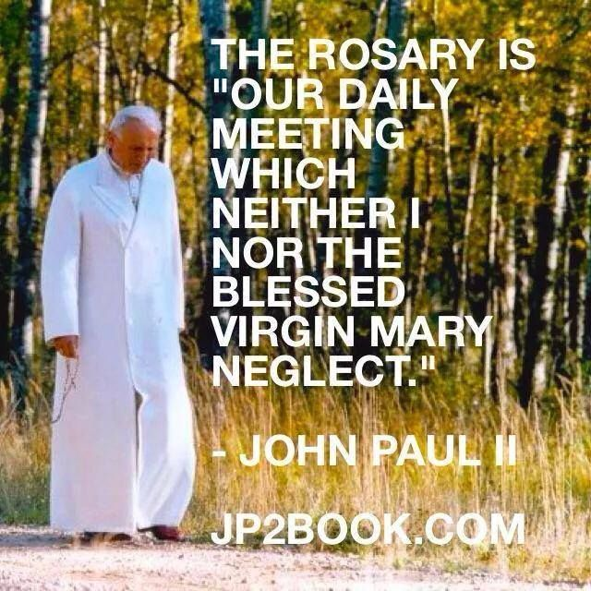

Notes:
At the beginning of his pontificate, St. John Paul II let everyone know that the Rosary was his favorite prayer.
Popes don't always reveal their personal preferences in public, but St. John Paul II wasn't afraid to reveal his favorite types of prayer.
In the second Angelus message of his pontificate in 1978, St. John Paul II said plainly, "The Rosary is my favorite prayer. A marvelous prayer! Marvelous in its simplicity and in its depth."
St. John Paul II affirmed this statement in his Apostolic Letter, Rosarium Virginis Mariae in 2002, pointing out how he revealed this aspect of his spiritual life so early on in his pontificate and how it continued to comfort him in good times and bad.
The Rosary has accompanied me in moments of joy and in moments of difficulty. To it I have entrusted any number of concerns; in it I have always found comfort. Twenty-four years ago, on October 29, 1978, scarcely two weeks after my election to the See of Peter, I frankly admitted: “The Rosary is my favorite prayer."
In a certain sense, if you want to know all the reasons why St. John Paul II loved the Rosary, all you need to do is read Rosarium Virginis Mariae. It contains an in-depth study of the Rosary and the many reasons why the Polish pontiff loved it.
St. John Paul II does list one of the primary reasons why he loves it, explaining how the Rosary is a path of contemplation.
[T[he most important reason for strongly encouraging the practice of the Rosary is that it represents a most effective means of fostering among the faithful that commitment to the contemplation of the Christian mystery which I have proposed in the Apostolic Letter Novo Millennio Ineunte as a genuine “training in holiness”: “What is needed is a Christian life distinguished above all in the art of prayer” ... The Rosary belongs among the finest and most praiseworthy traditions of Christian contemplation.
For St. John Paul II, not only did the Rosary provide a way to contemplate of the mysteries of the Gospel, it also looked to Mary, whom he believed was a "model of contemplation."
St. John Paul II did all that he could to promote the Rosary during his pontificate, sharing with the world its impact on his life, hoping that it could help us in our own spiritual journey.

Slide 29


FR PATRICK PEYTON
C.S.C.
Notes:
Father Patrick Peyton, C.S.C. was born in 1909 in Ireland to a devout Catholic Family. Praying the Rosary together each night was a routine in the Peyton household and laid a strong foundation for Father Peyton's faith. A farmer from a nearby village needed help picking potatoes. While staying with them, Patrick realized that this family is different than his, as there is no “Spirit of Faith” and no Family Rosary. Patrick decided to share his love for Mary and the Family Rosary with this family and they begin to pray the Rosary nightly.
Patrick was diagnosed with advanced and in 9 months wasn’t healing. Doctors offer Patrick two options: a risky surgery, with little hope for success, or simply to pray. A friend told him: "You have the Faith, Pat," he said, "but you’re not using it. You brought it with you from Ireland. Your mother gave it to you, just as her mother had given it to her."
Patrick prayed to Mary, Our Blessed Mother for a cure. In 2 weeks he knew in his heart that he had been cured. His depression, darkness and feeling of loneliness were replaced by lightness, freedom and hope. Patrick saw Our Lady in a new light: how human, approachable and sensitive she is to our needs.
Soon after ordination Father Pat began the Family Rosary Crusade.
On May 13, 1945, families all over the country heard a program like no other, featuring Archbishop Spellman of New York, President Harry Truman, Bing Crosby and the parents and sister of the Sullivan family of Iowa leading the Rosary. Five brothers from that family had lost their lives when their ship went down in the war. Father Peyton finished the program with an impassioned plea for families to pray the Rosary together for peace.
The program garnered the biggest following of any in the Mutual Broadcasting System to date. People wanted more!
Known the world over as “The Rosary Priest,” Father Peyton began Family Rosary, in Albany, N.Y. in 1942, with the goal of building family unity through daily prayer of the Rosary. Father Peyton went on to lead millions in prayer at over 540 Family Rosary Rallies that drew 28 million people, including 2 million each at events in Sao Paulo, Brazil and Manila, Philippines.

Slide 30



Father Lawrence Lew, OP: Appointed the General Promoter of the Rosary for the Dominican Order in 2019, his role is to coordinate the work of local rosary promoters around the world.
Father Joseph-Anthony Kress, OP: A Dominican friar and the promoter of the Rosary for the Province of St. Joseph, he leads the annual Dominican Rosary Pilgrimage in Washington, D.C.
Notes:
Fr Lawrence Lew’s stunning photographs of sacred art inspire his contemplations of each Mystery of the Rosary. Both the words and the images make the Mysteries we contemplate in this great prayer vivid and real, helping all of us – those who pray the Rosary faithfully and those who struggle with the devotion – to pray more deeply and with greater understanding. Once skeptical of all things Marian, Dominican Father Lawrence Lew now travels the world, preaching the Holy Rosary, ‘Mary’s gift to the entire Church.’ “Praying together brings people together,” Father Lawrence said, “and I think that is the great power of the Rosary: It unites us, and it brings us right into the heart of the universal Church. We recognize that we are a communion of saints, and the Rosary is Mary’s gift to the entire Church.” “there is this beautiful idea that, as we pray, we are praying spiritual dewdrops that bring refreshment and new life to a parched world.” The Rosary, (the Dominican Father continued,) “is therefore all the more needed so that we can water the earth with the dewfall of God’s grace, the dewfall of the Holy Spirit.”
Fr Joseph Anthony Kress leads the annual Dominican Rosary Pilgrimage at the Basilica of the Immaculate Conception yearly. He said: “The Rosary is “ever ancient, ever new.” It’s always central to Dominican life and preaching, but every generation discovers it afresh. I’ve seen how young people and new converts especially cling to the Rosary — not as just a pious activity, but as a way of life. In a world that feels formless, the Rosary provides structure and formation, helping us focus on Christ through Mary.” “My hope is simple: that more people encounter Jesus through Mary. That’s the victory — each person united to Christ.“

Slide 31



Father Donald Calloway, MIC:
A priest and author who has written books on the rosary, he frequently speaks at conferences and leads pilgrimages to Marian shrines.
Notes:
Favorite Devotions: Rosary, Divine Mercy, Fr. Donald Calloway, MIC, a convert to Catholicism, is a member of the Congregation of Marian Fathers of the Immaculate Conception. Before his conversion to Catholicism, he was a high school dropout who had been kicked out of a foreign country, institutionalized twice, and thrown in jail multiple times. After his radical conversion things really started to happen in his life . . .

Slide 32






The Rosary
With Bishop Robert Barron
Pray the Rosary with Bishop Barron as you meditate upon beautiful artwork from the Church’s rich history depicting each mystery.
Through Word on Fire
An Eagle Scout created this Rosary Walk at St Anthony Mary Claret in San Antonio
Father Mark-Mary Ames, CFR:
A Franciscan Friar of the Renewal who hosts a video series on the rosary through Ascension Press.
Notes:
Spirit juice kids, Paradisus Dei (youtube formed and site), word on fire, ascension press, EWTN kids Rosary (youtube)

Slide 33
MIRACLES OF THE ROSARY
During War and for Peace

Slide 34



BATTLE OF LEPANTO
Notes:
The rosary gained greater popularity in the 1500s, when Moslem Turks were ravaging Eastern Europe. Recall that in 1453, Constantinople had fallen to the Moslems, leaving the Balkans and Hungary open to conquest. With Moslems raiding even the coast of Italy, the control of the Mediterranean was now at stake.
The year was 1571 and the Turkish naval fleet of the Ottoman empire was threatening to conquer Europe for Islam. Pope Pius V (now a saint) called on Christian nations to send ships and men to defend themselves from the invaders.
The Turkish fleet was the mightiest and most disciplined naval force on the planet at the time of the battle. Victory seemed impossible from the inferior Christian army, but nevertheless, “The Holy Fleet” prepared for battle.
Pope Pius V called upon Catholics to begin praying the Rosary continuously and on October 7, 1571, the two armies met in the harbor of Lepanto. Though originally it appeared that the Holy Fleet would suffer a quick defeat, the supernatural aid of hundreds of thousands of Catholics praying the Rosary results in a defeat of the Turkish army! The once-powerful Turkish military was defeated and the Christian slaves onboard were set free!
At the very hour of the victory, Pope Pius V (more than a thousand miles away), rose from his chair and proclaimed a Catholic victory! He declared October 7th would be the feast of Our Lady of Victory in thanksgiving for her aid of the Holy Fleet.

Slide 35




"Give me an army saying the Rosary and I will conquer the world."
—Pope Bl. Pius IX
Notes:
MIRACULOUS PROTECTION FROM ATOMIC BOMB IN HIROSHIMA: When an atomic bomb was dropped on Hiroshima, Japan everything within a mile was annihilated. The only survivors within that one mile radius were eight priests. These 8 men walked away from the atomic blast and lived into old age without radiation poisoning. –Taylor Marshall
“ Not only did they all survive with (at most) relatively minor injuries, but they all lived well past that awful day with no radiation sickness, no loss of hearing, or any other visible long term defects or maladies. Naturally, they were interviewed and examined numerous times (Fr. Schiffer, a survivor, said over 200 times) by scientists and health care people about their remarkable experience and they say “we believe that we survived because we were living the message of Fatima. We lived and prayed the rosary daily in that home.”
GUNS FELL TO ROSARIES IN A BLOODLESS REVOLUTION: Standing in pairs, Sister Ocariza and 16 other nuns led the rosary as soldiers escorted rolling military tanks with their turrets trained on them. She said staring down those tanks has been the scariest experience of her life. “I said, ‘Lord forgive me for all my sins and even the offenses of our Filipino people.’ If really the tanks would crush us, … kill us sisters, not the people because we (did not) want bloodshed. I love my country.” But the tanks stopped, and the soldiers joined the protesters reciting the rosary,’ that was really a miracle!
TWO MEN FROM THE SAME FAMILY WERE SAVED FROM DEATH BECAUSE OF A ROSARY IN TWO DIFFERENT WARS: Private Glenn Hockton bent down to pick his up rosary that had fallen off his neck-a move that alerted him that he had stepped on a landmine in Afghanistan. He stood still where he was for 45 minutes while his colleagues defused the mine. He wasn’t the first one in his family to narrowly escape death because of rosary. Glenn’s great-grandfather Joseph Sunny Truman also credited a rosary with saving his life when a bomb blast ahead of him missed him by a hair because he stopped to pick up a rosary he saw on the ground.

Slide 36
BENEFITS OF PRAYING
THE ROSARY
Notes:
"If you persevere in reciting the Rosary, this will be a most probable sign of your eternal salvation."
—Blessed Alan de la Roche
“The Rosary is the best therapy for these distraught, unhappy, fearful, and frustrated souls, precisely because it involves the simultaneous use of three powers: the physical, the vocal, and the spiritual, and in that order.” Venerable Fulton Sheen

Slide 37
The 15 Promises of Our Lady to Those Who Pray the Rosary
1) To all those who shall recite my rosary devoutly, I promise my special protection and very great graces.
2) Those who shall persevere in the recitation of my rosary shall receive special graces.
3) The rosary shall be a very powerful armor against hell; it will destroy vice, deliver from sin, and dispel heresy.
4) The rosary will make virtue and good works flourish, and will obtain for souls the most abundant divine mercies; it will draw the hearts of men from the love of the world to the love of God, and will lift them to the desire of eternal things. How many souls shall sanctify themselves by this means!
5) Those who trust themselves to me through the rosary shall not perish.
6) Those who shall recite my rosary devoutly, meditating on its mysteries, shall not be overwhelmed by misfortune. The sinner shall be converted; the just shall grow in grace and become worthy of eternal life.
7) Those truly devoted to my rosary shall not die without the Sacraments of the Church.
8) Those who faithfully recite my rosary shall find during their life and at the hour of their death the light of God, the fullness of his graces, and shall share in the merits of the blessed.
9) I shall deliver very promptly from purgatory the souls devoted to my rosary.
10) The true children of my rosary shall enjoy great glory in heaven.
11) What you ask through my rosary, you shall obtain.
12) Those who propagate my rosary will be aided by me in all their necessities.
13) I have obtained from my Son that all the members of the Rosary Confraternity shall have as their intercessors, in life and in death, the entire celestial court.
14) Those who recite my rosary faithfully are all my beloved children, the brothers and sisters of Jesus Christ.
15) Devotion to my rosary is a great sign of predestination.
* The above list is taken from a book by the Servant of God Patrick Peyton.1" as quoted in "Champions of the Rosary: The History and Heroes of a Spiritual Weapon" by Donald H. Calloway

Slide 38



For members of the Rosary Confraternity, a plenary indulgence, under the usual conditions, is granted:
  on the day of enrollment. (When application is made, a certificate of membership is sent, indicating the day of the enrollment.)
  on the following feast days: Christmas, Easter, Annunciation, Purification, Assumption, Our Lady of the Rosary, and Immaculate Conception.
For those who pray the Rosary, a plenary indulgence is granted under the usual conditions, when the Rosary is prayed in Church, or in a Public Oratory, in a family (family Rosary), Religious Community, or Pious Association. Otherwise a partial indulgence is granted.

Slide 39


Slide 40
ROSARY RESOURCES

Slide 41
SUPPLIES
ROSARY ARMY – MAKE THEM, PRAY THEM, GIVE THEM AWAY! – “We’ve been teaching people to make, pray, and give away rosaries for 20 years. All our work is about helping people discover freedom in Christ through closeness to His mother.” http://rosaryarmy.com
OUR LADY’S ROSARY MAKERS - OLRM provides low cost materials, resources, and support www.olrm.org
CONFRATERNITY OF THE HOLY ROSARY - The Rosary Confraternity is a pious association of the Catholic Church, under the care of the Order of Preachers, “to praise and honor the Blessed Virgin Mary and to secure her patronage by the recitation of the Rosary for the mutual spiritual benefit of all the members throughout the world. https://dominicanconfraternity.org/rosary
DOCUMENTS
ON THE ROSARY (Ingravescentibus Malis) (29 Sep 1937) - Pope Pius XI https://www.vatican.va/content/pius-xi/en/encyclicals/documents/hf_p-xi_enc_29091937_ingravescentibus-malis.html
ON RECITING THE ROSARY (Ingruentium Malorum) (15 Sep 1951) - Pope Pius XII - urges us to "fly with greater confidence to the Mother of God. There, the Christian people have always sought chief refuge in the hour of danger, because she has been constituted the cause of salvation for the whole human race. https://www.vatican.va/content/pius-xii/en/encyclicals/documents/hf_p-xii_enc_15091951_ingruentium-malorum.html
ON THE ROSARY (Grata Recordatio) (26 Sep 1959) Pope John XXIII - This encyclical covers the rosary, prayer for the Church, the missions and international and social problems; https://www.vatican.va/content/john-xxiii/en/encyclicals/documents/hf_j-xxiii_enc_26091959_grata-recordatio.html
ROSARIUM VIRGINIS MARIAE – Rosary of the Virgin Mary – Pope St. John Paul II
www.vatican.va/content/john-paul-ii/en/apost_letters/2002/documents/hf_jp-ii_apl_20021016_rosarium-virginis-mariae.html

Slide 42
BOOKS
The Secret of the Rosary by Louis de Montfort
Champions of the Rosary by Donald H. Calloway
Mysteries Made Visible: Praying the Rosary with Sacred Art by Fr. Lawrence Lew O.P.
The Rosary: The Prayer That Saved My Life by Immaculee Ilibagiza Steve Erwin
The Contemplative Rosary with St. John Paul II and St. Teresa of Avila by Connie Rossini, Dan Burke
VIDEOS
The Rosary, Spiritual Sword of Our Lady | Fr Donald Calloway, MIC https://www.youtube.com/watch?v=SYiotFvaZBo
The Rosary: Not Vain, but Biblical (Part 1) - Explaining the Faith – Fr Chris Alar - https://www.youtube.com/watch?v=RwUHmYNaCxY (follow with Part II)

