Slide 1
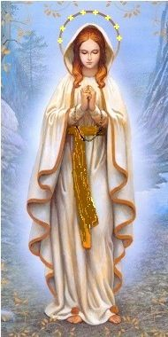
Marian
Apparitions
A geographic and doctrinal overview
August 2025
Annette Winfield

Slide 2
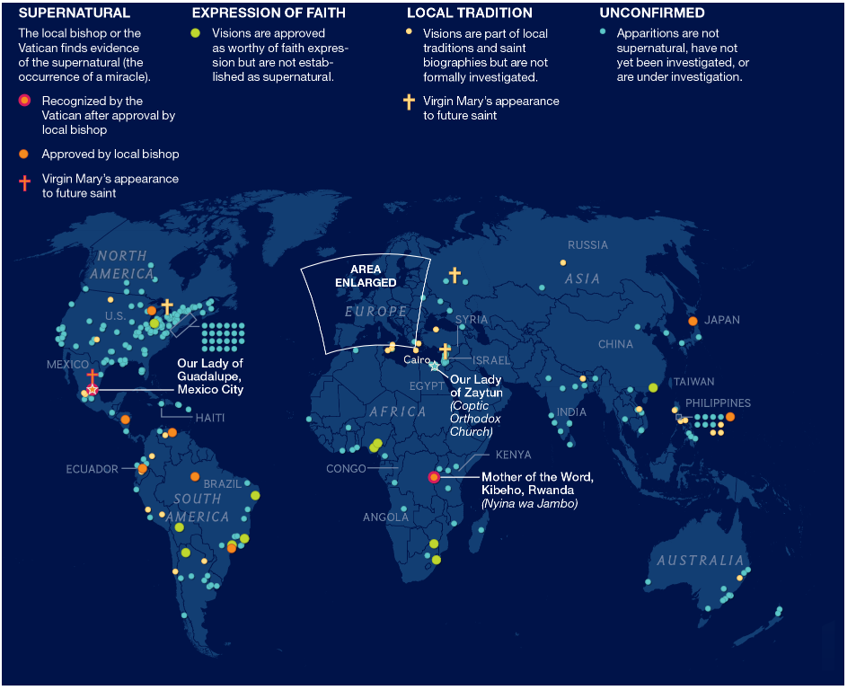

Slide 3
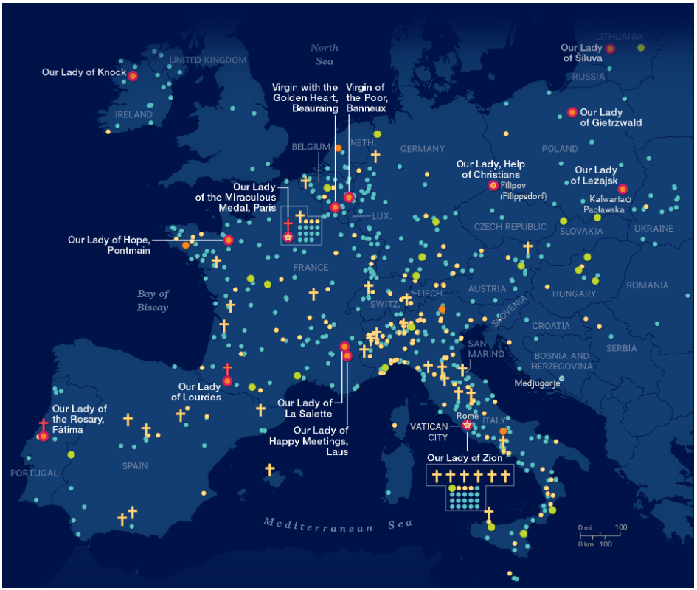

Slide 4
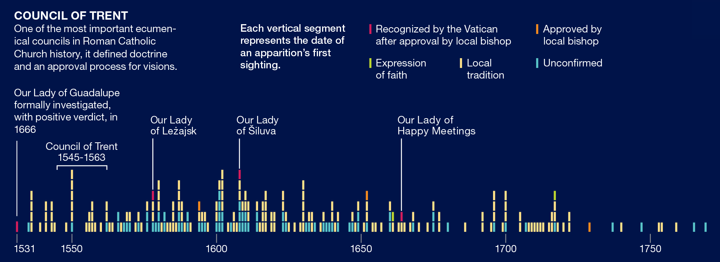

Slide 5
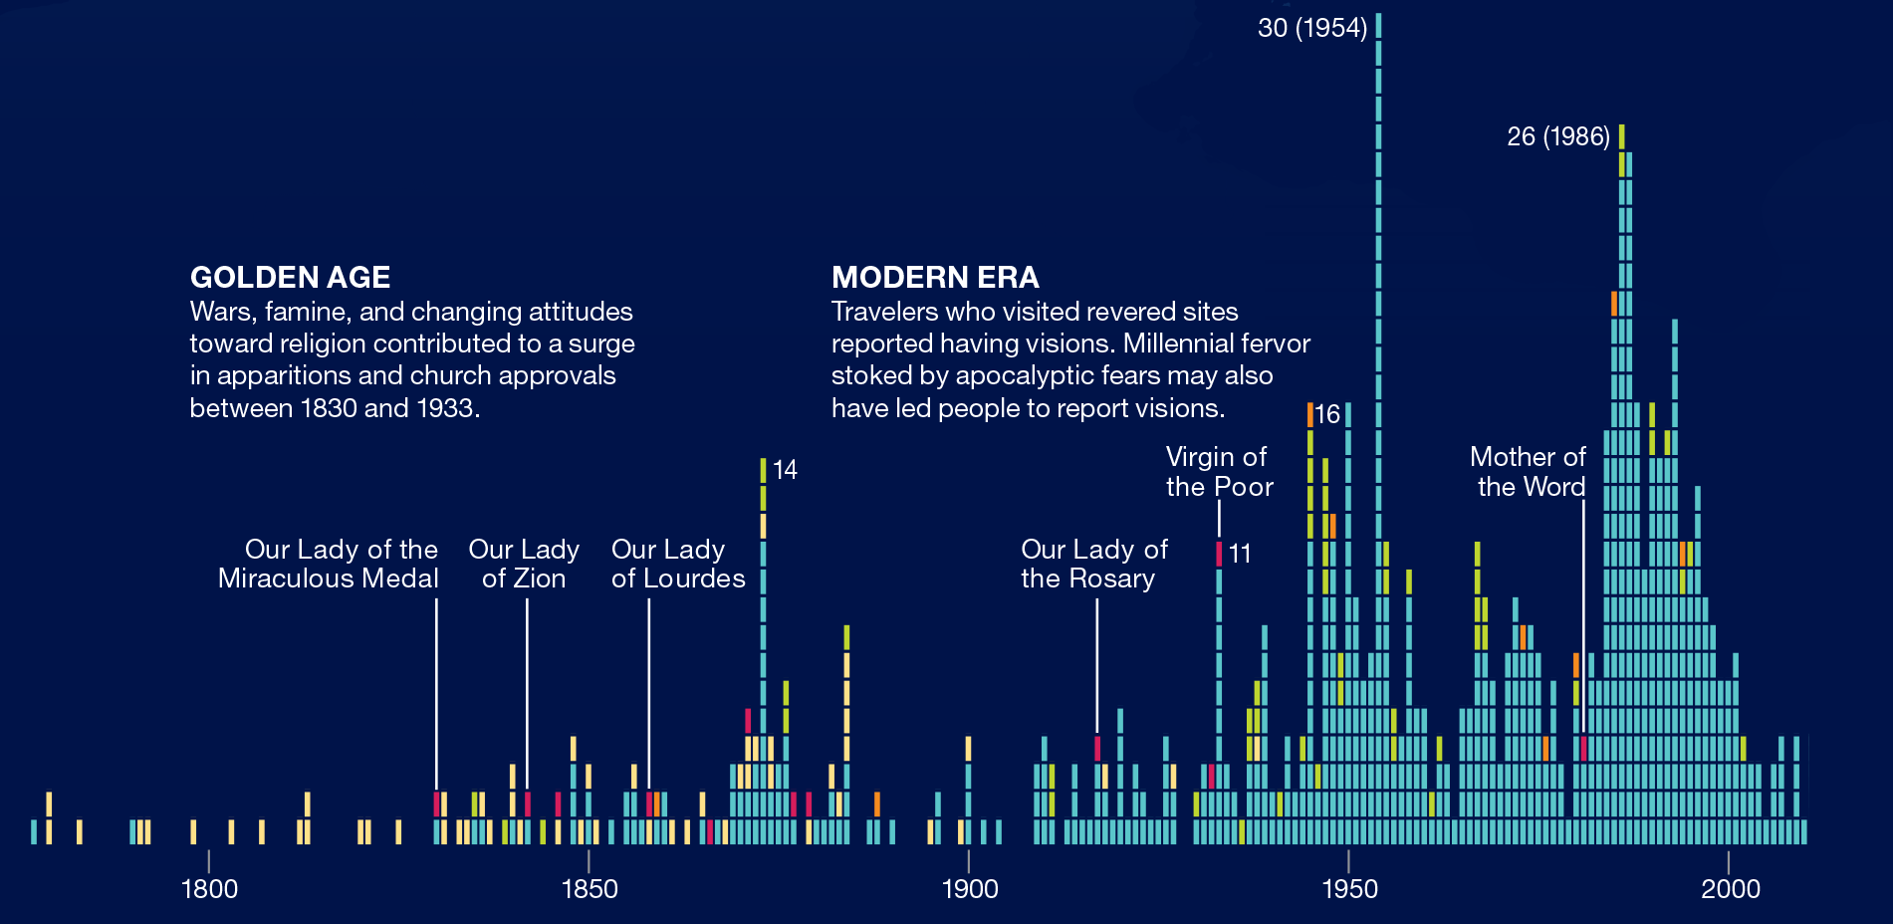

Slide 6
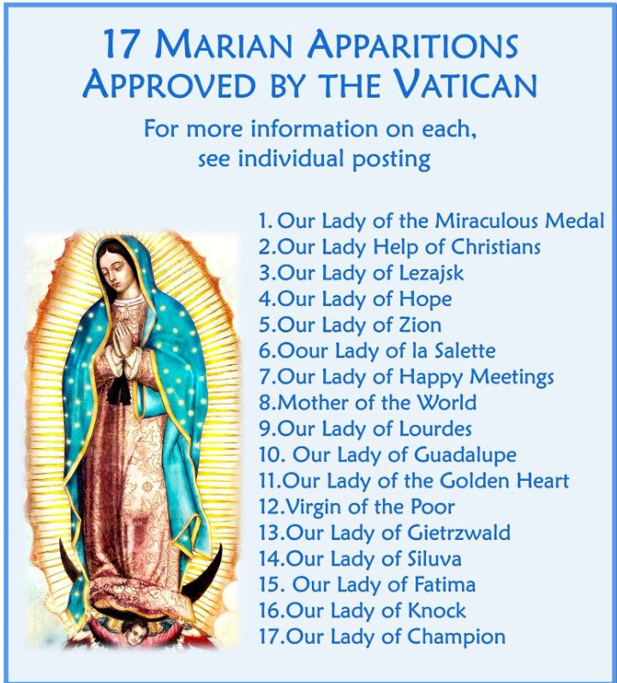

Slide 7
Positive Criteria:
The credibility and good reputation of the persons who claim to be recipients of supernatural events or to be directly involved in them, as well as the reputation of the witnesses who have heard.
The doctrinal orthodoxy of the phenomenon and any messages related to it.
The unpredictable nature of the phenomenon, by which it is evident that it is not the result of the initiative of the people involved.
The fruits of the Christian life, including a spirit of prayer, conversions, vocations to the priesthood and religious life, acts of charity as well as sound devotion and abundant and constant spiritual fruits.

Slide 8
B) Negative Criteria:
The possibility of a manifest error about the event.
Potential doctrinal errors.
A sectarian spirit that breeds division in the Church.
An overt pursuit of profit, power, fame, social recognition, or other personal interest closely linked to the event.
Gravely immoral actions committed by the subject or the subject’s followers at or around the time of the event.
Psychological alterations or psychopathic tendencies in the person that may have exerted an influence on the alleged supernatural event.

